Slide 1
Welcome to all
for the MHRM Online lecture
By
Dr. Dhiraj Ovhal
HOD of Commerce

Slide 2
Chapter no 4
Key Marketing Dimensions

Slide 3
Q.2 Market leader and Market Challenger ,Market Follower
Market leader | Market Challenger | Market Follower
Top position | 2 nd and 3rd position | Follow and last position
Amul.Cadbury, Jio | Dabur | Duplicate or pirated

Slide 4
Market leader
Reliance Industries.
Tata Consultancy Services (TCS)
HDFC Bank.
Hindustan Unilever (HUL)
H D F C.
ICICI Bank.
Kotak Mahindra Bank.
HCL Technologies.

Slide 5
Market Challenger
Definition: A market challenger is a company which tries to expand its market share by aggressively flooding the market with its products at competitive prices. A market challenger is a firm or a company which is usually at the No.2 or No.3 position.
For example, Apple came out with the multi touch smart phones, but today Samsung is leading that market in terms of total turnover. Thus there are several market follower strategies in effect in today’s business environment. Market followers are bound to exist in a mature market.

Slide 6
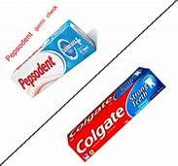
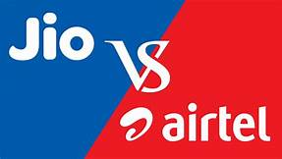
Q.3 Guerrilla Advertising:-
It means to adopt conventional & unconventional means of attack to demoralise the competitors.
Ex- Jio Vs Airtel.
Colgate Vs Pepsodent

Slide 7
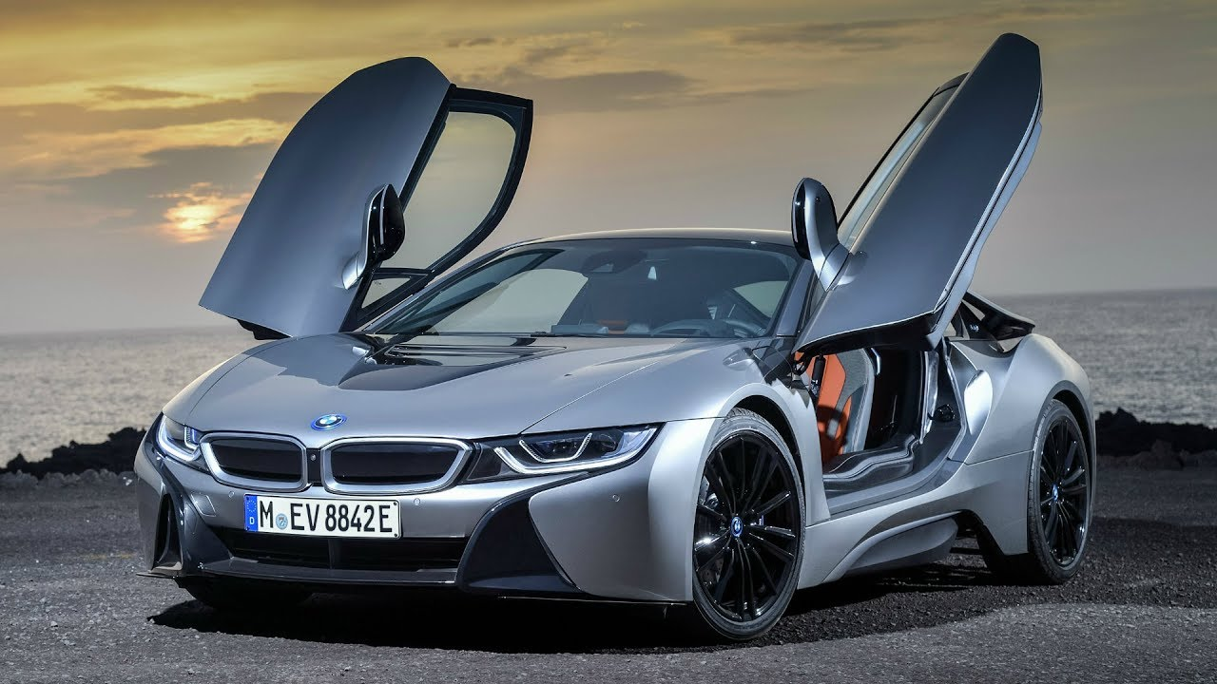
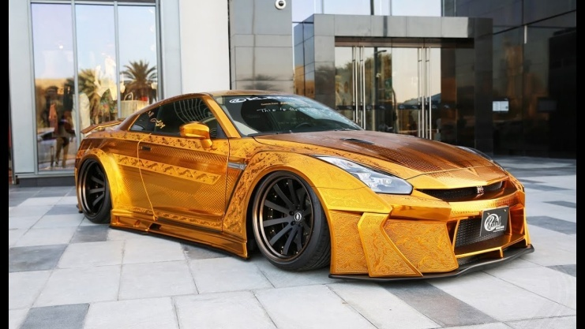
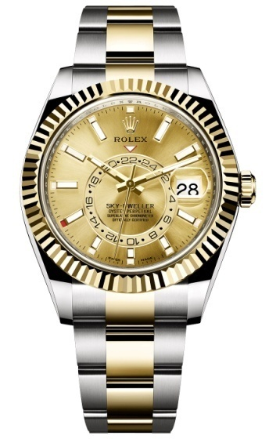
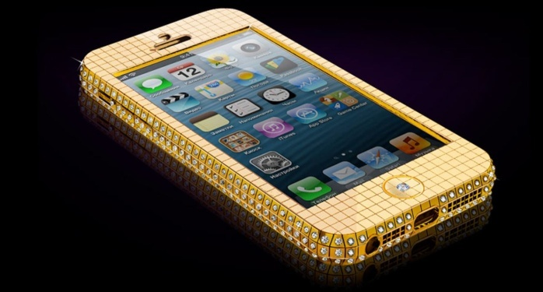
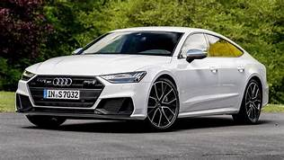
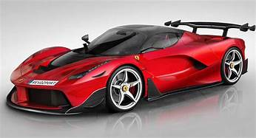
Q.4 Niche Marketing :- Very small marketing segment basically for luxurious products :- like Roles watches, Audi, BMW , Rolls Royce car, etc.

Slide 8
Q.4 Niche Marketing :- Very small marketing segment basically for luxurious products :- like Roles watches, Audi, BMW , Rolls Royce car, etc.
A niche market is a small market segment. Normally small firm enter in niche markets, because the niche segment that the larger firms may not have the desire to cater However, there are large and reputed firms that u marketing, which include Rolls Royce, Rolex Watches

Slide 9
1. Less Investment :
The niche marketer requires less investment as produce limited goods for the niche market. The niche requires lower investment in production and marketing activities.

Slide 10
2.Less Risks :
There may be less risks as the marketing is done to a very small segment of the market. For example, the risk of loss technological changes or changes in fashion may be lower

Slide 11
3.Higher Profits:
Niche marketing may generate higher profits per unit sold because of lower operating costs in terms of advertising and other expenses. However, it is to be noted that companies also make losses. For instance, Bugatti International that sells Veyron Car - second most expensive in the world - makes losses.

Slide 12
4.Brand Loyalty :
Customers may become brand loyal. The customers may continue to repeat the purchases of the same brand and they may even recommend it to their friends and others.

Slide 13
5. Corporate Image:
The niche marketer can earn name and reputation in the market. For instance, companies like Rolex Watches, Rolls Royce, etc. command a lot of goodwill.

Slide 14
6. Competitive Advantage :
Niche marketers normally face less competition in the market as they deal with a specific product for a small segment of the market . Competitors may like to enter the market due to lower volume of sales.

Slide 15
7. Customer Satisfaction:
Niche marketing generates customer satisfaction. This is because, the marketer gets first hand information about customers and accordingly designs the product to meet the expectations of niche customers

Slide 17
Q.5. Rural Marketing It is also called Village marketing .70 % population lives in rural areas. More than 93 crore population in villages. Total number of village 6,40,000.

Slide 18
Features of rural marketing:-
S 2 AGM L 3.
Scattered nature of Indian Market
Size of Rural Market
Awareness
Growth of certain products
Mode of payment
Leaders’ opinions
Life style
Literacy level

Slide 19
Q.6 Strategy for Rural Marketing
1.Communication strategy
2.Distribution strategy
3.Warehousing strategy
4.Sales force management
S 2
5.Sales promotion strategy
6.Product strategy
7.Price strategy
8.Place strategy
P 5
9.Promotion strategy
10.Packaging strategy

Slide 20
Q.7 Digital Marketing:- It is called as Digital marketing and online marketing. It was first used in 1990.It makes use of Smart phones, digital boards, tablet, computer, laptop, etc.

Slide 21
Forms or types of digital marketing
Internet marketing:- online marketing. B2B,B2C,C2C,C2B
1. Social Media marketing:- use of social platform Whatsaap, Face-book, etc.
2. Viral marketing:-strategy focus on spreading information & opinions about products
Inbound telemarketing : receive call
Tele marketing
Outbound Marketing : Make call
5. Mobile Marketing:- It includes SMS , Direct Call

Slide 22
Q.8. Trends in digital Marketing
Artificial Intelligence
Customer experience
Multichannel marketing
Social Media :- Whatsapp, Face book,
Augmented realties :- Pokeman go—video game
Growing importance of Video- Tiktok Video
Personal branding by celebrities : Shilpa Shetty- Yoga and Mediation
Story telling

Slide 23
Q.9 Green Marketing:- AMA defines “Green marketing is the marketing of products that are presumed to be environmentally safe or friendly”
Importance of green marketing:-
Safe / protection Environment
Public health
Corporate image
Competitive advantages
CRM C5
Consumer education
Consumer behaviour

Slide 24
Q.10 Challenges are faced by the Marketing Manager under the 21st Century
1.Challenges of Global marketing :- China products threats
2. Challenges of compress product life cycle:- Tata Nano—short life cycle
3. Customer awareness
4. Challenges of technological booms
5. Emergence of Social media

Slide 25
Q.11 Career in Marketing
Marketing manager-
Advertising manager
-MIS
Sales promotion manager-
Brand manager
CRM
Product development Manager
SALES Manager
Purchase manager
After sales manager

Slide 26
Q.12 Skills required for effective marketing
Managerial skill
Marketing skill
Communication skills
Leadership skills
Decision making skills
Problem solving skills
Stress resilience skill
Human skill
Other skills

Slide 27
Q.13 Reason for failure of the brands in India
( Tata Nano- Nestle cool tea, gold spot soft drink ,etc..are failed in Indian Market)
i. Faulty product design
ii. High pricing
iii. Faulty distribution
iv. Poor promotion mix
v. Lack of CRM
vi. Poor after sales
vii. Higher maintenance cost
viii. Other reasons:- technology changes

Slide 28
Thank You

Slide 29
Attendance Link
https://forms.gle/Xqvykv5vfEi1zpyF7
(Mention date at last point)

